Slide 1
OPERATING SYSTEMS (CS F372) OS Structures
Barsha Mitra
CSIS Dept., BITS Pilani, Hyderabad Campus

Slide 2
Operating System Services
User interface
Program execution
I/O operations
File-system manipulation
Communications
Error detection
Resource Allocation
Protection & Security

Slide 3
System Calls
Interface to the services provided by the OS
Typically written in a high-level language (C or C++)
System calls are not directly used
Mostly accessed by programs via a high-level Application Programming Interface (API)
API specifies a set of functions available to application programmers
Programmers access API via code library provided by the OS
3 most common APIs
Win32 API for Windows
POSIX API for POSIX-based systems (all versions of UNIX, Linux, Mac OS X)
Java API for the Java virtual machine (JVM)

Slide 4
System Calls
A number is associated with each system call
System-call interface maintains a table indexed according to these numbers
System call interface invokes the intended system call in OS kernel and returns status of the system call and any return values
Caller need know nothing about system call implementation
Needs to obey API and understand what OS will do as a result of call execution
Most details of OS interface hidden from programmer by API

Slide 5
Types of System Calls
Process control
create process, terminate process
end, abort
load, execute
get process attributes, set process attributes
File management
create file, delete file
open, close file
read, write file
get and set file attributes
Device management
request device, release device
read, write
get device attributes, set device attributes
logically attach or detach devices
Information Maintenance
Communication
Protection

Slide 6
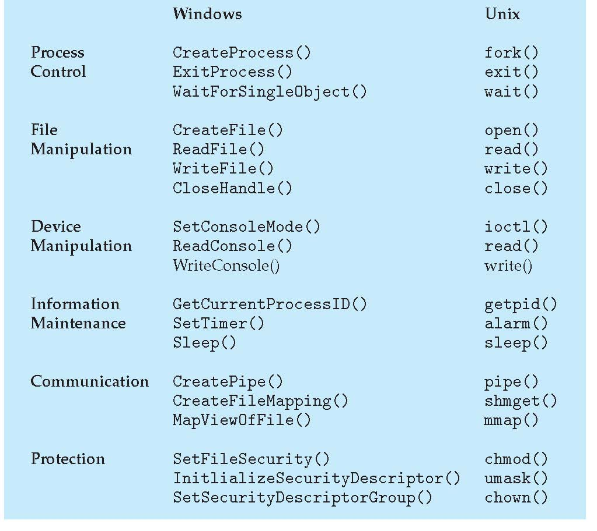
Examples of System Calls

Slide 7
OS Structure
Simple Structure
Monolithic Kernel
Layered Approach
Microkernels
Modules

Slide 8
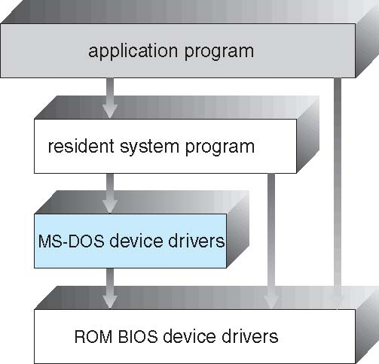
Simple Structure
no well defined structure
not divided into modules
interfaces and levels of functionality are not well separated
application programs are able to access the basic I/O routines to write directly to the display and disk drives
vulnerable to malicious programs, causing entire system crashes when user programs fail

Slide 9
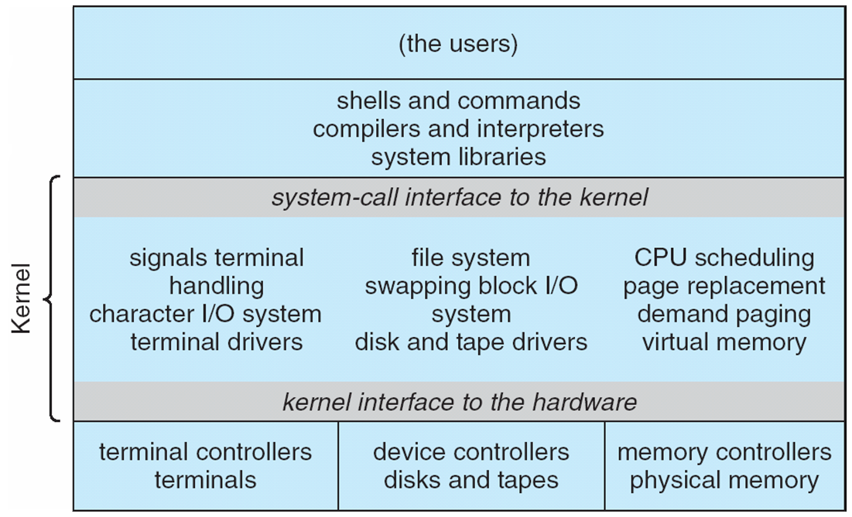
UNIX Architecture
original UNIX operating system had limited structuring
consists of two separable parts
systems programs
kernel
Consists of everything below the system-call interface and above the physical hardware
Provides the file system, CPU scheduling, memory management, and other operating-system functions
Large number of functions for one level

Slide 10
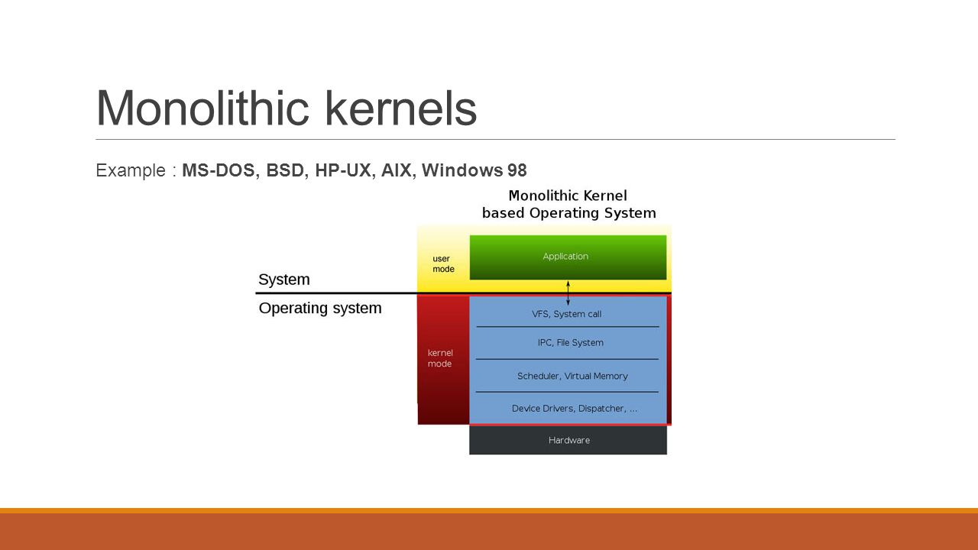
Monolithic Kernel
entire operating system is working in kernel space
larger in size
little overhead in system call interface or in communication within kernel
faster
hard to extend
if a service crashes, whole system is affected
Eg., - Linux, Solaris, MS-DOS

Slide 11
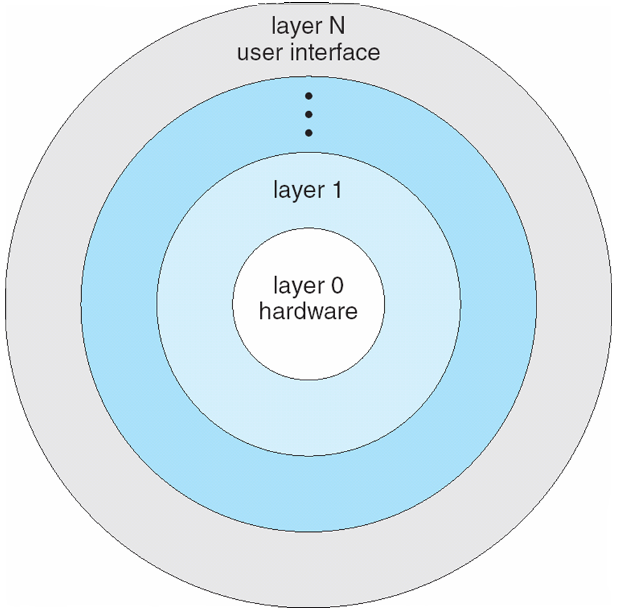
Layered Approach
The operating system is divided into a number of layers (levels), each built on top of lower layers
The bottom layer (layer 0), is the hardware; the highest (layer N) is the user interface
Each layer uses functions (operations) and services of only lower-level layers

Slide 12
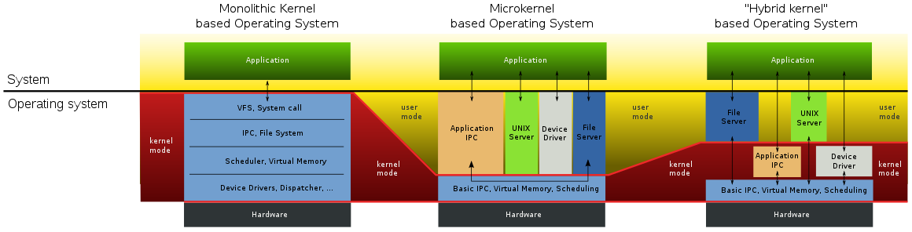
Microkernel
user services and kernel services are in separate address spaces
smaller in size
slower
extendible, all new services are added to user space
if a service crashes, working of microkernel is not affected
more secure and reliable
eg., Mach, QNX, Windows NT (initial release)
Drawback ???
Performance overhead of user space to kernel space communication

Slide 13
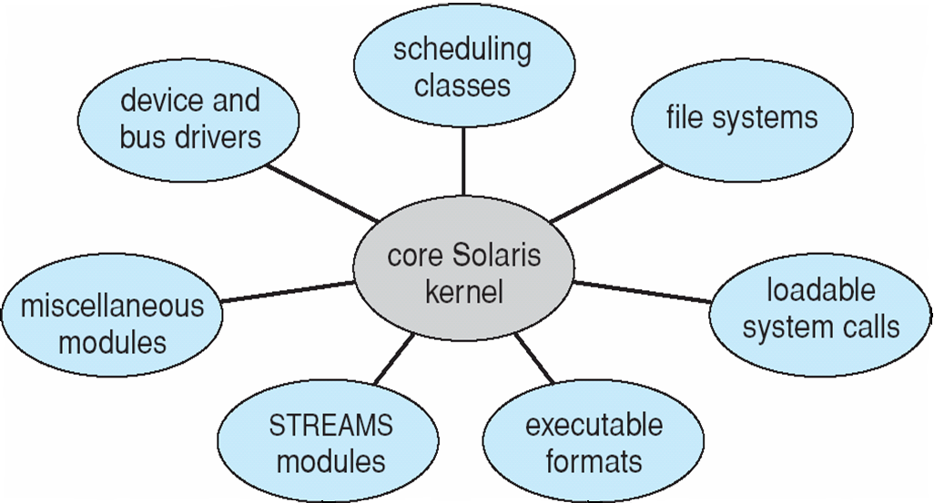
Modules
loadable kernel modules
kernel has a core set of components
links in additional services via modules, either at boot time or during run time
each module has a well defined interface
inter module communication via the interface
object-oriented approach
dynamically linking services is preferable to adding new features directly to the kernel → does not require recompiling the kernel for every change
better than a layered approach → any module can call any module
better than microkernel → no message passing required to invoke modules
Solaris, Linux, Max OS X

Slide 14
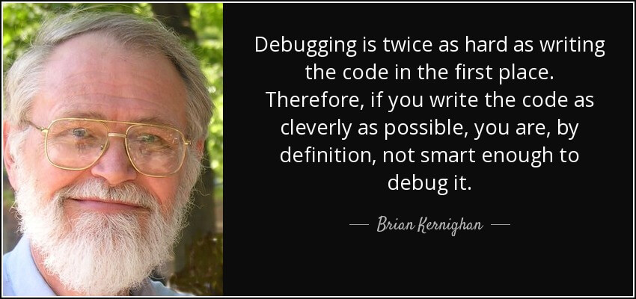
Operating-System Debugging
Debugging is finding and fixing errors, or bugs
OS generates log files containing error information on process failure
Failure of an application can generate core dump file capturing memory of the process for later analysis
Operating system failure can generate crash dump file containing kernel memory

Slide 15
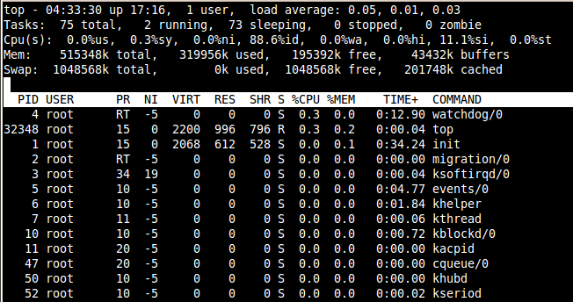
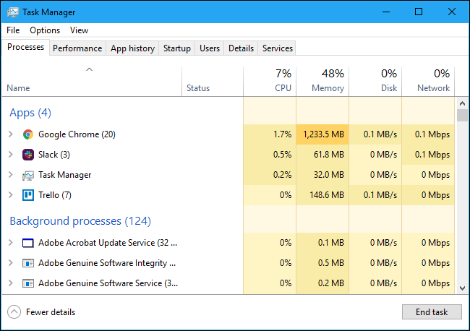
Performance Tuning
Improve performance by removing bottlenecks
Using trace listings of system activities, recorded for analysis
OS must provide means of computing and displaying measures of system behavior
Tools - top program or Windows Task Manager

Slide 16
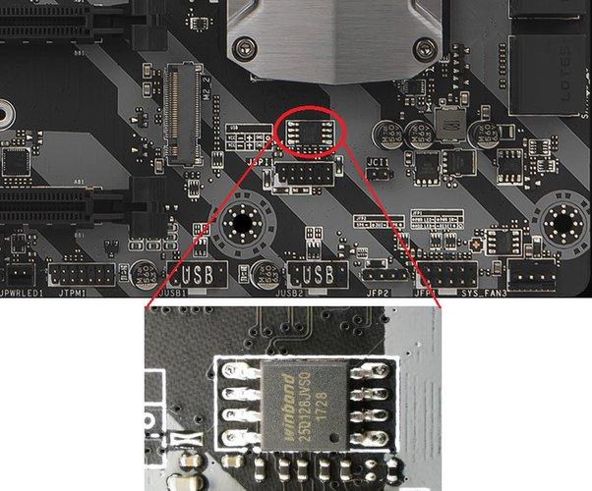
System Boot
BIOS
Non-volatile firmware
Stored on EPROM
Stored on a chip on motherboard
Performs POST
POST (Power-On Self-Test) is the diagnostic testing sequence that BIOS runs to determine if the computer keyboard, random access memory, disk drives, and other hardware are working correctly

Slide 17
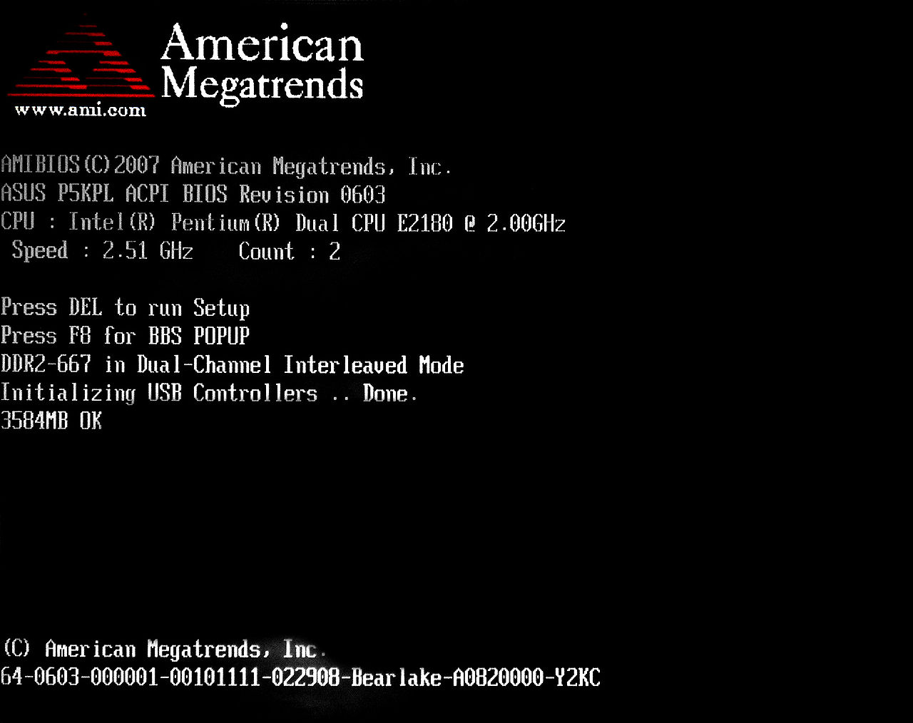
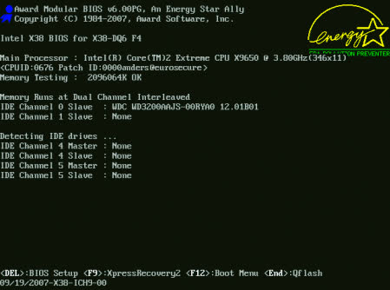
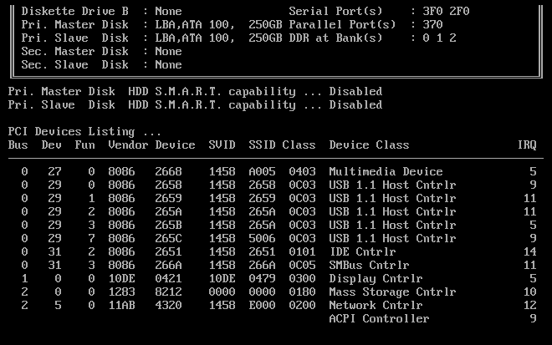
System Boot

Slide 18
System Boot
BIOS
Runs POST
Does h/w initialization
Reads boot block content into RAM (1st level boot loader)
dedicated block usually at the beginning of a storage medium
holds special data used to start a system
some systems use a boot block of several physical sectors, while some use only one boot sector
boot disk – disk containing a boot block
boot partition – disk partition containing a boot block
1st Level Bootloader
May contain the remaining bootstrap program
Address and length of 2nd level bootloader on disk
2nd Level Bootloader
Traverses the file system to locate OS kernel
Loads kernel into memory
Starts its execution

Slide 19
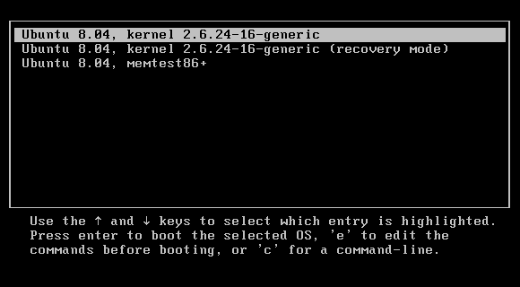
GRUB
GRand Unified Bootloader
Bootloader package from GNU project
Provides user the choice to boot one of the OSs installed on a computer

Slide 20
Thank You

